Slide 1
F. Y. BCA
Subject – Web Development Using PHP
Chapter 4 – Arrays Functions
Dr. Savita Mohurle

Slide 2
list()
This function is used to copy values from array to the variables.
Syntax: list(var1, var2, ...)
<?php
$cities=array('Mumbai','Delhi','Nagpur');
list($cn,$cs,$c)=$cities;
echo "$cn, $cs and $c";
?>
Output: Mumbai, Delhi and Nagpur

Slide 3
array_splice()
This function is used to remove or insert elements in array.
Syntax: array_splice(array, start, length, array)
<?php
$student=array(11,12,13,14,15,16);
$new_student=array_splice($student,2,3);
//starting from index(2) and length =3
print_r($new_student);
echo "<br>";
$new_student1=array_splice($student,2);
//here length is not mentioned
print_r($new_student1);
?>
Output : Array ( [0] => 13 [1] => 14 [2] => 15 ) Array ( [0] => 16 )

Slide 4
array_key_exists()
This function is used to check if an element exist in the array. It returns TRUE if given key is present in array
Syntax: array_key_exists(key, array)
<?php
$cities=array( 'Capital of Nation'=>'Delhi', 'Capital of state'=>'Mumbai', 'My city'=>'Nashik');
if (array_key_exists('Capital of state',$cities))
{
echo "key found!\n";
}
?>
Output: key found!

Slide 5
extract()
This function automatically creates local variables from the array.
<?php
$a = "Original";
$my_array = array("RollNo" => "111","Name" => "Saksham", "Class" => "Std V");
extract($my_array);
echo "\$RollNo = $RollNo; \$Name = $Name; \$Class = $Class";
?>
Output: $RollNo = 111; $Name = Saksham; $Class = Std V

Slide 6
foreach()
This is the most common way to loop over elements of an array. PHP executes the body of the loop once for each element of $students, with $value set to the current element.
<?php
$students=array('Rohan','Rahul','Rohit','Ravi');
foreach($students as $value)
{
echo "student : $value <br>";
}
?>

Slide 7
Output:
student : Rohan student : Rahul student : Rohit student : Ravi

Slide 8
array_push()
These functions are used to treat an array like a stack.
Syntax: array_push(array)
<?php
$a=array("red","green");
array_push($a,"blue","yellow");
print_r($a);
?>
<?php
$a=array("a"=>"red","b"=>"green");
array_push($a,"blue","yellow");
print_r($a);
?>

Slide 9
Output (Pink code)
Array ( [0] => red [1] => green [2] => blue [3] => yellow )
Output (Green code)
Array ( [a] => red [b] => green [0] => blue [1] => yellow )

Slide 10
array_pop()
These functions are used to treat an array like a stack.
Syntax: array_push(array)
<?php
$a=array("red","green","blue");
array_pop($a);
print_r($a);
?>
Output: Array ( [0] => red [1] => green )

Slide 11
array_shift() - remove
These functions are used to treat an array like a queue.
Syntax: array_shift(array)
<?php $a=array("a"=>"red","b"=>"green","c"=>"blue"); echo array_shift($a); print_r ($a);
?>
Output: Array ( [b] => green [c] => blue )

Slide 12
array_unshift() - insert
These functions are used to treat an array like a queue.
Syntax: array_unarray_unshift(array1,value1,value2......valuen )
<?php
$fruits_list = array('Red', 'Green');
array_unshift($fruits_list, 'Blue', 'Orange');
print_r($fruits_list);
?>
Output:
Array ( [0] => Blue [1] => Orange [2] => Red [3] => Green )

Slide 13
Adding value to the end of array
<?php
$a=array("red","green","blue");
$a[]="ddd";
print_r($a);
?>
Output:
Array ( [0] => red [1] => green [2] => blue [3] => ddd )

Slide 14
isset()
Checks whether a variable is set, which means that it has to be declared and is not NULL. This function returns true if the variable exists and is not NULL, otherwise it returns false.
Syntax : isset(variable, ....);
<?php Output: Value is set to variable a.
$a = 10;
// True because $a is set
if (isset($a)) {
echo "Value is set to variable a.<br>";
}
$b = null;
// False because $b is NULL
if (isset($b)) {
echo "null is set to variable a.<br>";
}
?>

Slide 15
isset()
<?php
$student=("RollNo"=>"111","Name"=>null,"Class"=>"STDIV");
var_dump(isset($student["Name"]));
echo "<br>";
if(array_key_exists("Class",$student))
echo "Yes Class Key exists";
else
echo "No Class Key does not exists";
echo "<br>";
var_dump(isset($student["RollNo"]));
?>

Slide 16
Output:
D:\wamp\www\demoarray.php:3:boolean false
Yes Class Key exists
D:\wamp\www\demoarray.php:10:boolean true

Slide 17
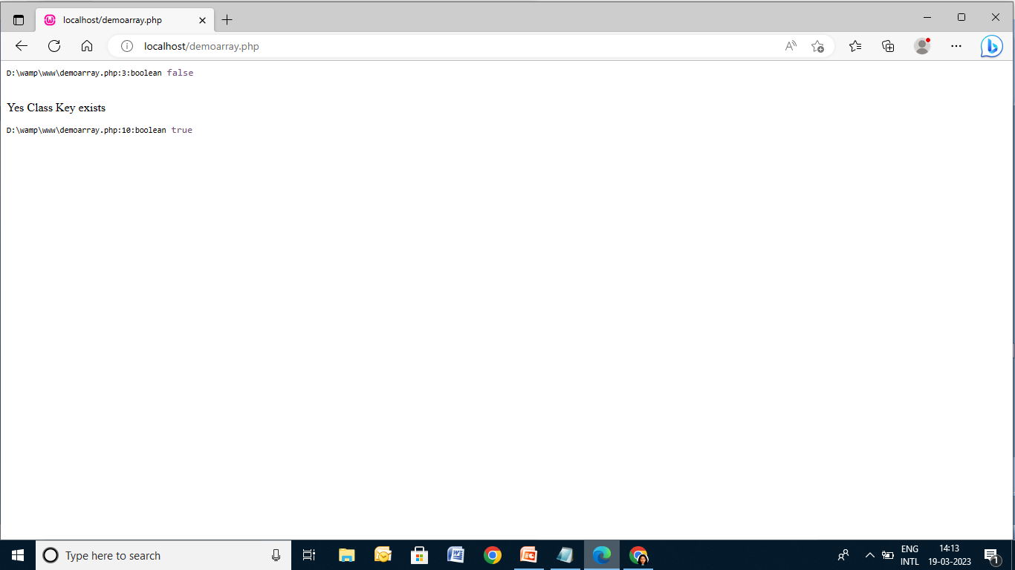

Slide 18
unset()
unsets a variable.
Syntax : unset(variable, ....);
<?php
$a = “SBUP";
echo "The value of variable 'a' before unset: " . $a . "<br>";
unset($a);
echo "The value of variable 'a' after unset: " . $a;
?>

Slide 19
unset()
unsets a variable.
Syntax : unset(variable, ....);
<?php
$a = array(1,2,3,4,5);
echo "Before unset :<br>";
print_r($a);
echo "<br>After unset :<br>";
unset($a[2]);
print_r($a);
?>

Slide 20
Output:
Before unset : Array ( [0] => 1 [1] => 2 [2] => 3 [3] => 4 [4] => 5 ) After unset : Array ( [0] => 1 [1] => 2 [3] => 4 [4] => 5 )

Slide 21
reset()
Set the internal pointer of an array to its first element.
Syntax : reset ( array &$array )
<?php
$array = array('1','2','3','4');
// by default, the pointer is on the first element
echo "Current: ".current($array) . "<br />\n"; // output 1
// skip two steps
next($array);
next($array);
echo "Current: ". current($array) . "<br />\n"; // output 3
// reset pointer, start again on step one
reset($array);
echo "Current: ".current($array) . "<br />\n"; // output 1
?>

Slide 22
Output:
Current: 1 Current: 3 Current: 1

Slide 23
array_sum()
Return the sum of all the values in the array
Syntax : array_sum(array);
<?php
$a=array(5,15,25);
echo array_sum($a);
?>
Output : 45 Output : 45
<?php
$a=array('a','b','c');
echo array_sum($a);
?>
Output: 0
<?php
$a=array("a"=>52.2,"b"=>13.7,"c"=>0.9);
echo array_sum($a);
?>
Output: 66.8
<?php
$a=array('5','15','25');
echo array_sum($a);
?>

Slide 24
Example
Write a menu driven program to perform the following operations on an associative array:
a) Display the elements of an array along with the keys.
b) Display the size of an array
c) Delete an element from an array from the given key/index.
d) Reverse the order of each element’s key-value pair
[Hint: use array_flip()]
e) Traverse the elements in an array in random order
[Hint: use shuffle()].

Slide 25
<html>
<form action=“FirstArray.php" method="GET">
Enter keys of an array :<input type="text" name="t1"><br><br>
Enter elements of an array: <input type="text" name="t2"><br><br>
<input type="radio" name="r1" value="f">Display elements of array along with key<br>
<input type="radio" name="r1" value="s">Display size of array<br>
<input type="radio" name="r1" value="d">Delete element from given key/index<br>
Enter the key/index to delete element<input type="textbox" name="t3"><br>
<input type="radio" name="r1" value="r">Reverse the order of each elements key-value pair<br>
<input type="radio" name="r1" value="t">Traverse the elements in an array in random order<br>
<input type="submit" value="ok"></form></body></html>

Slide 26
Thank You

